Slide 1
Understanding cities with open source tools and open data
Shrividya (Shriv) Ravi
Te Manatū Waka (Ministry of Transport, NZ)

Slide 2
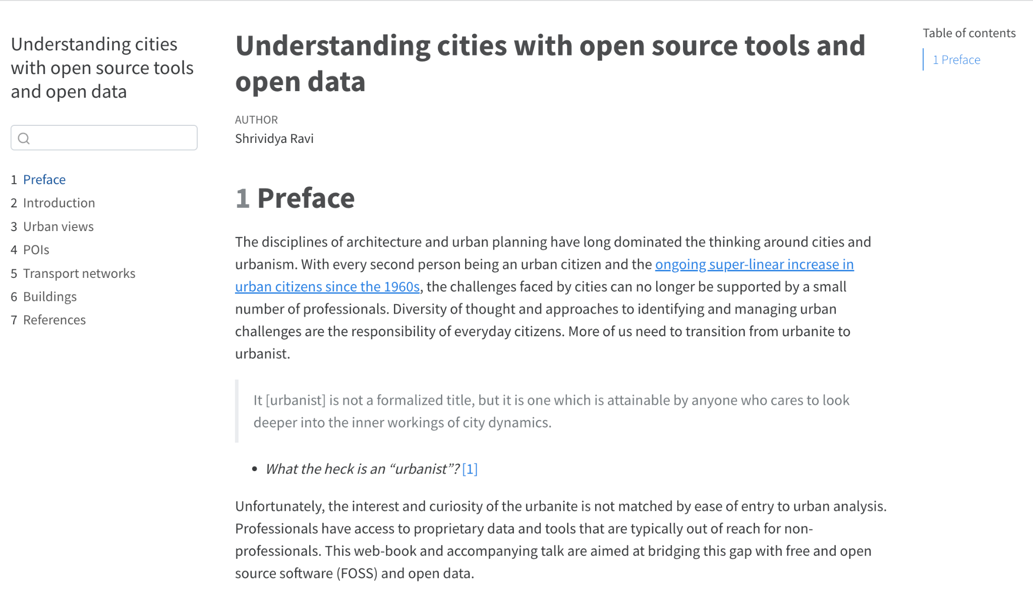
Chapters
https://github.com/shriv/foss4g-2023
https://shriv.github.io/foss4g-2023/
Introduction
Urban views
Points of Interest
Transport networks
Buildings

Slide 3
Introduction

Slide 4

Urbanite to urbanist
“It is not a formalized title, but it is one which is attainable by anyone who cares to look deeper into the inner workings of city dynamics.”
People Thought by Gan Khoon Lay
Quote from Strong Towns blog

Slide 5
Urbanite to urbanist
“.. actively pursuing more complete understandings of the city issues before us from a myriad of different disciplines.”
People Thought by Gan Khoon Lay
Quote from Strong Towns blog

Slide 6
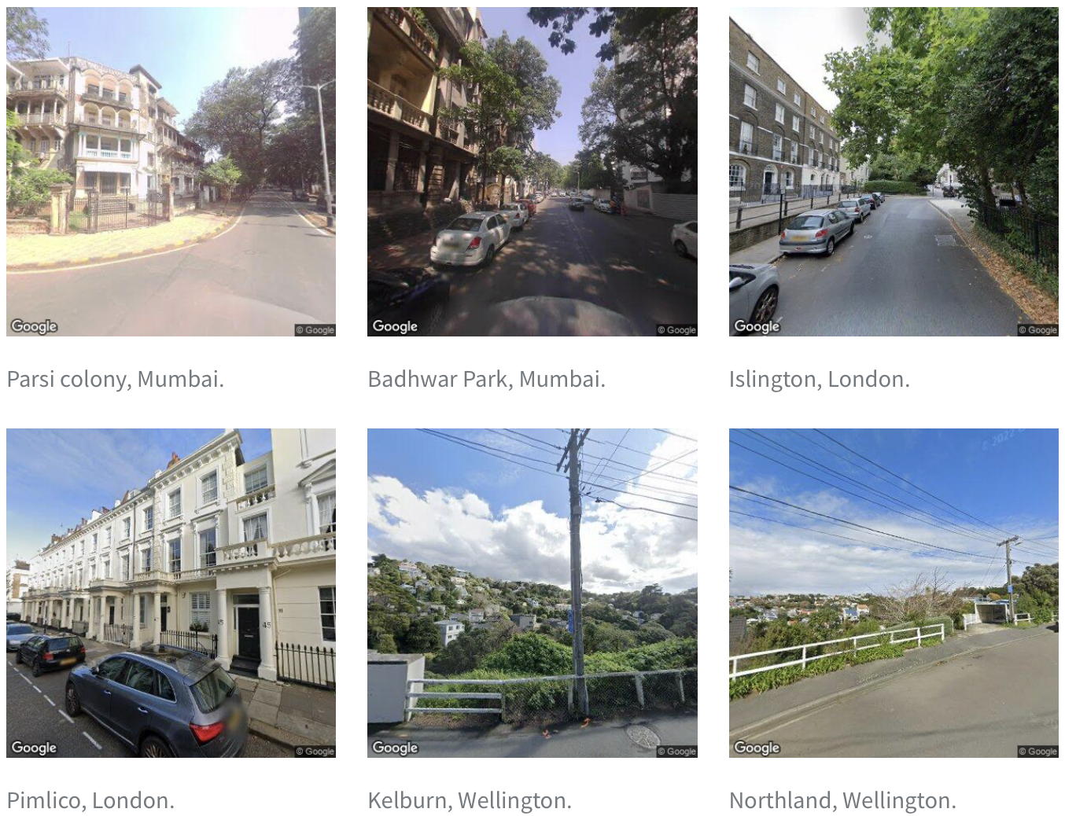
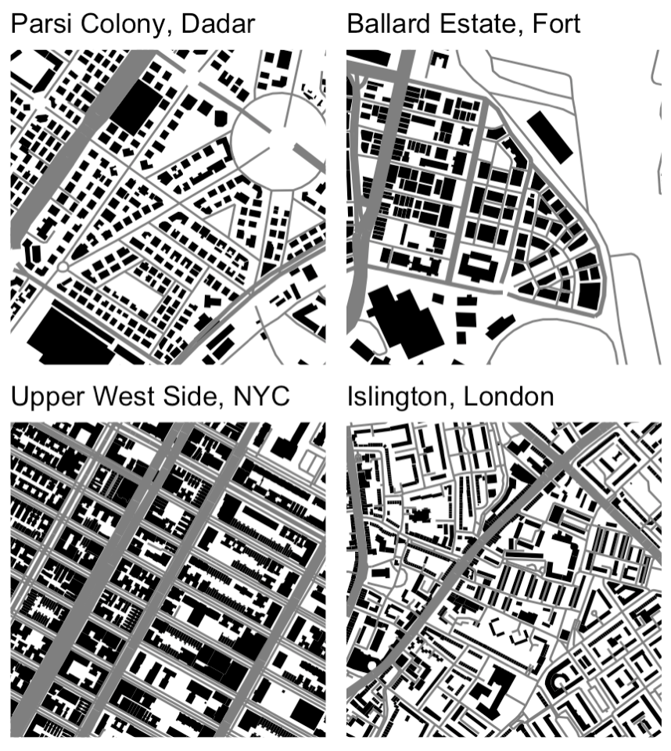
Visual narratives created with code

Slide 7


Pirate (R) or Snake (Python)
The typical upskilling is to begin with learning coding for data science (rather than software development) and then progressing to geospatial data science.
Visualisation and statistical modelling: R
Machine learning: Python

Slide 8
Urban views

Slide 9
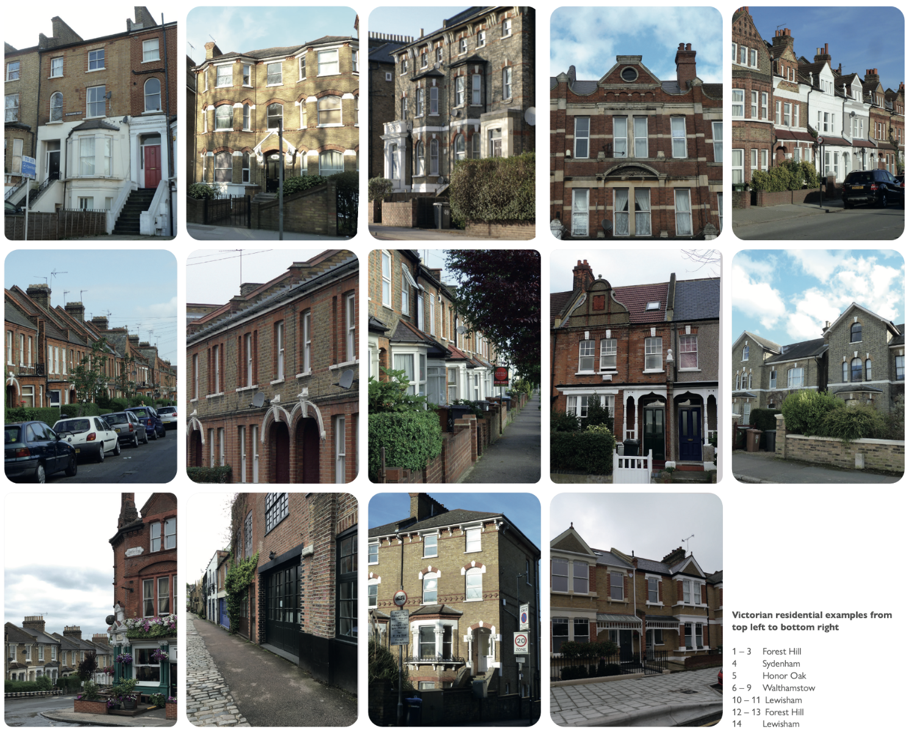
Collages of urban character
Striking similarity in Victorian architecture without the buildings looking like clones.
Houses are stuck close together
Architectural emphasis on large windows and setbacks
Image reproduced from Complexcity

Slide 10
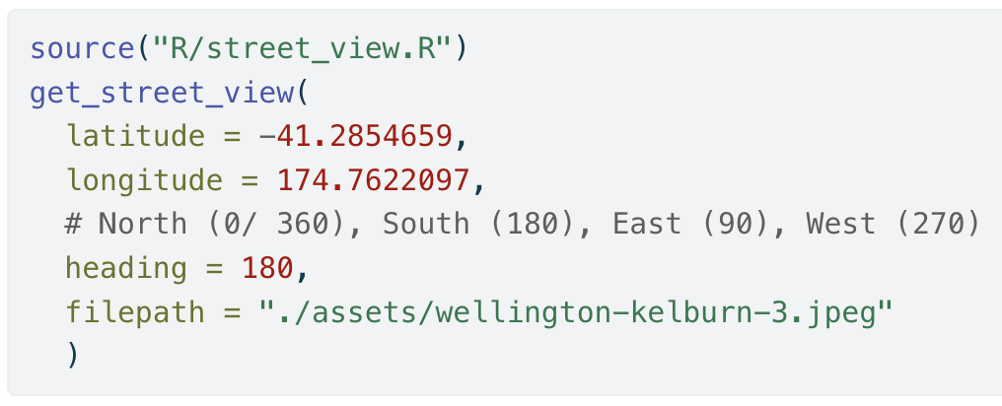
Armchair flâneur / flâneuse
Single function that can be repeated for any view around the world.
Build your own urban collage!
Pictures obtained with googleway package.

Slide 11
Points of Interest (POIs)

Slide 12
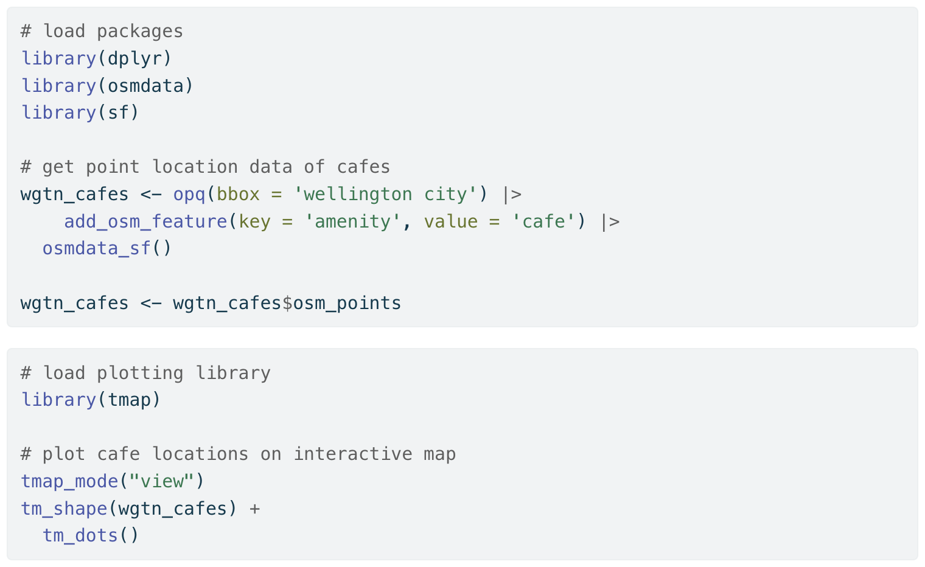
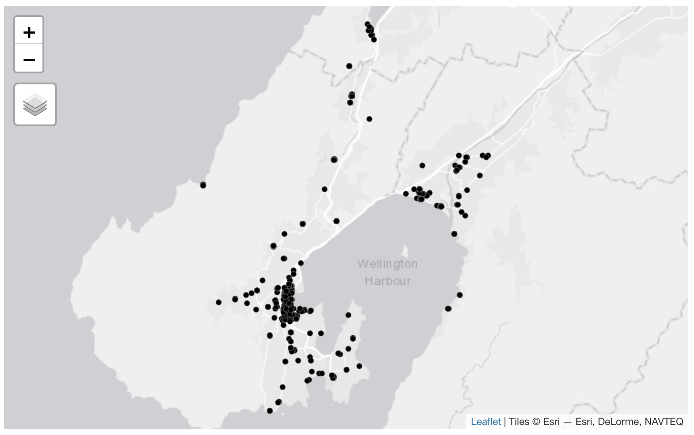
Getting data from OpenStreetMap

Slide 13
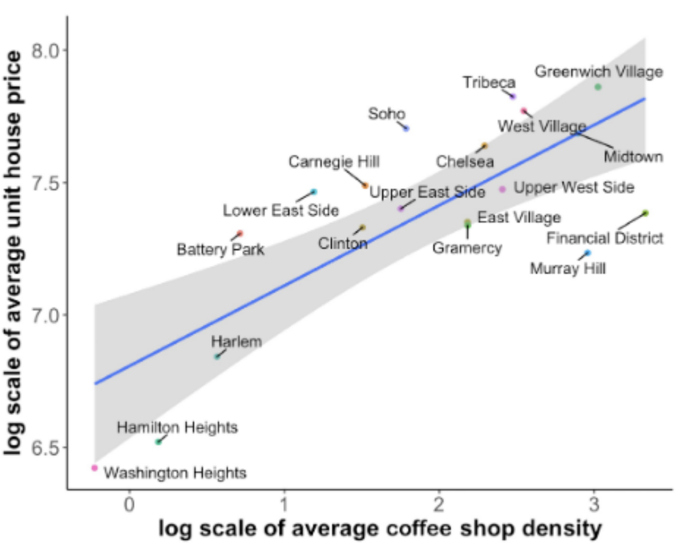
City phenomena: cafes and house prices
Urban processes of demand mean that businesses tend to cluster in certain areas.
The same processes behind clustering of amenities can cause / be correlated with residential preference increasing land value and thus house prices.
Image reproduced from 10.1371/journal.pone.0212606.

Slide 14
Transport networks

Slide 15
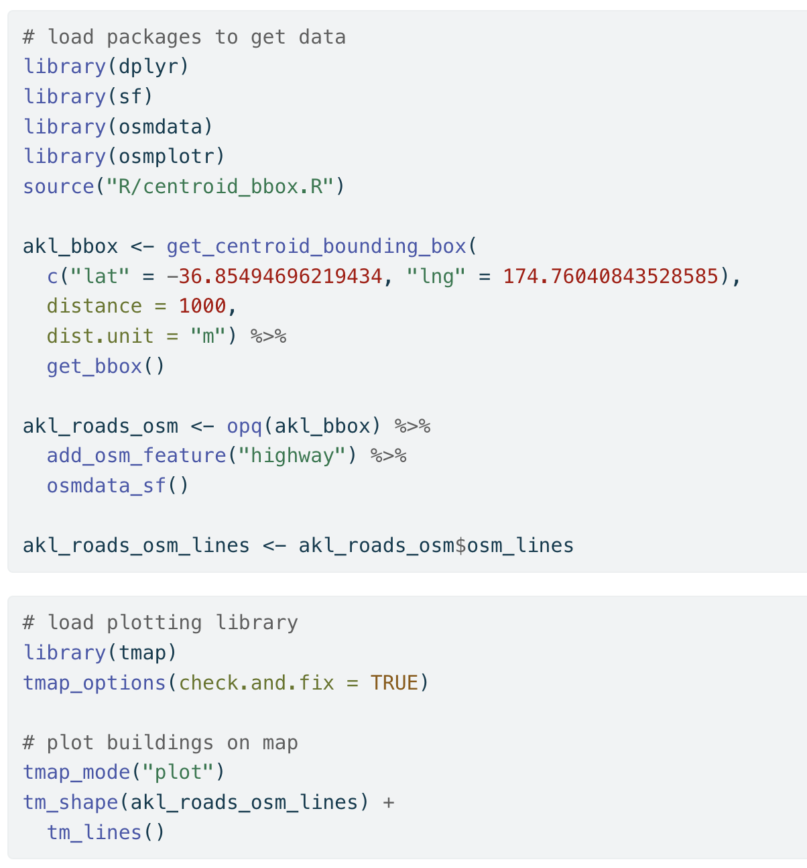
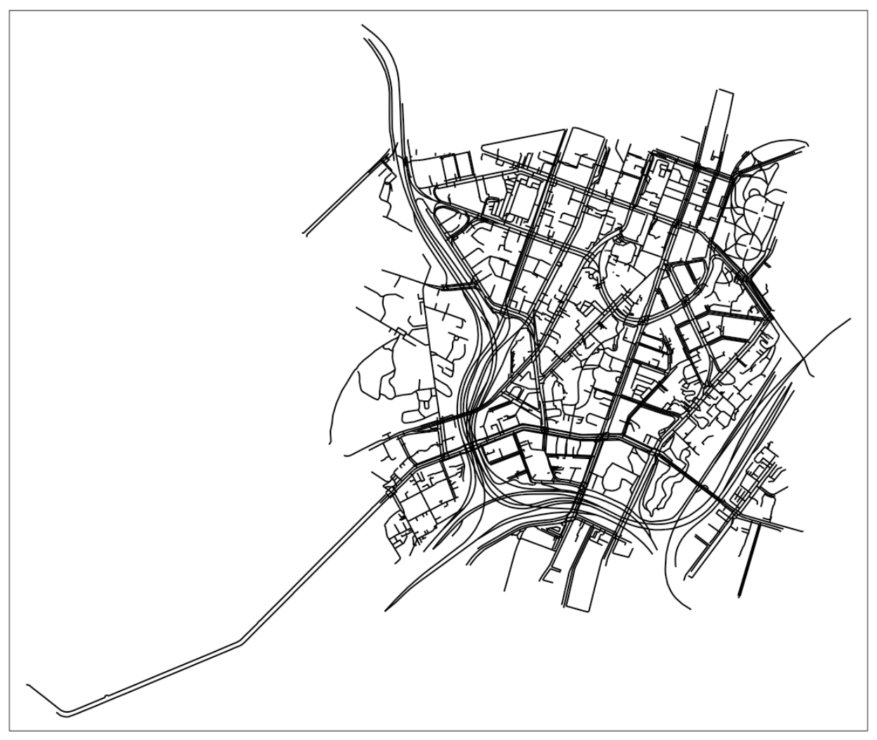
Getting data from OpenStreetMap

Slide 16
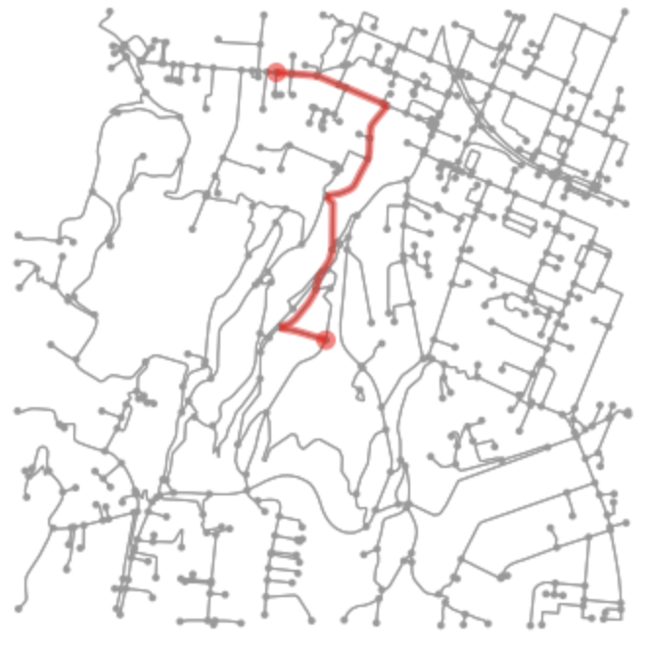
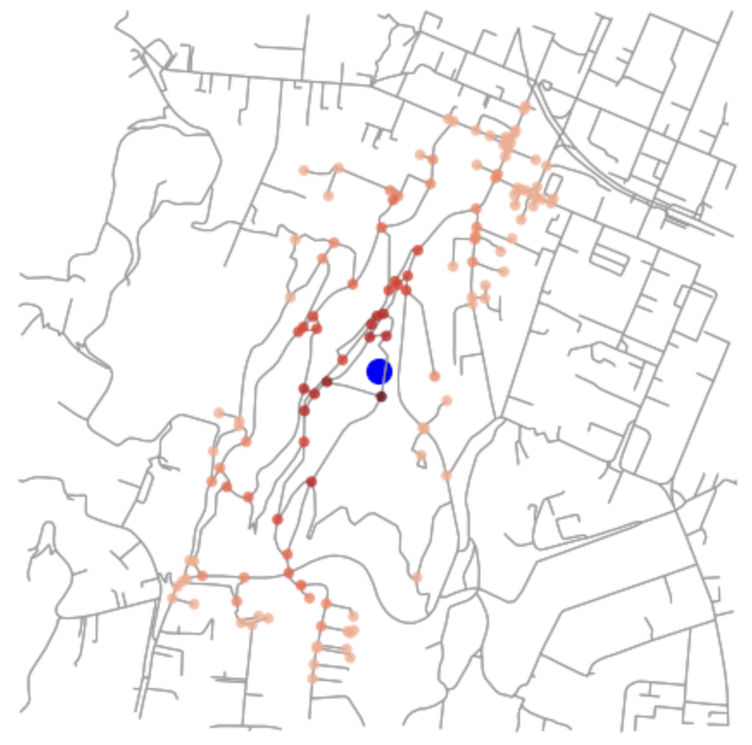
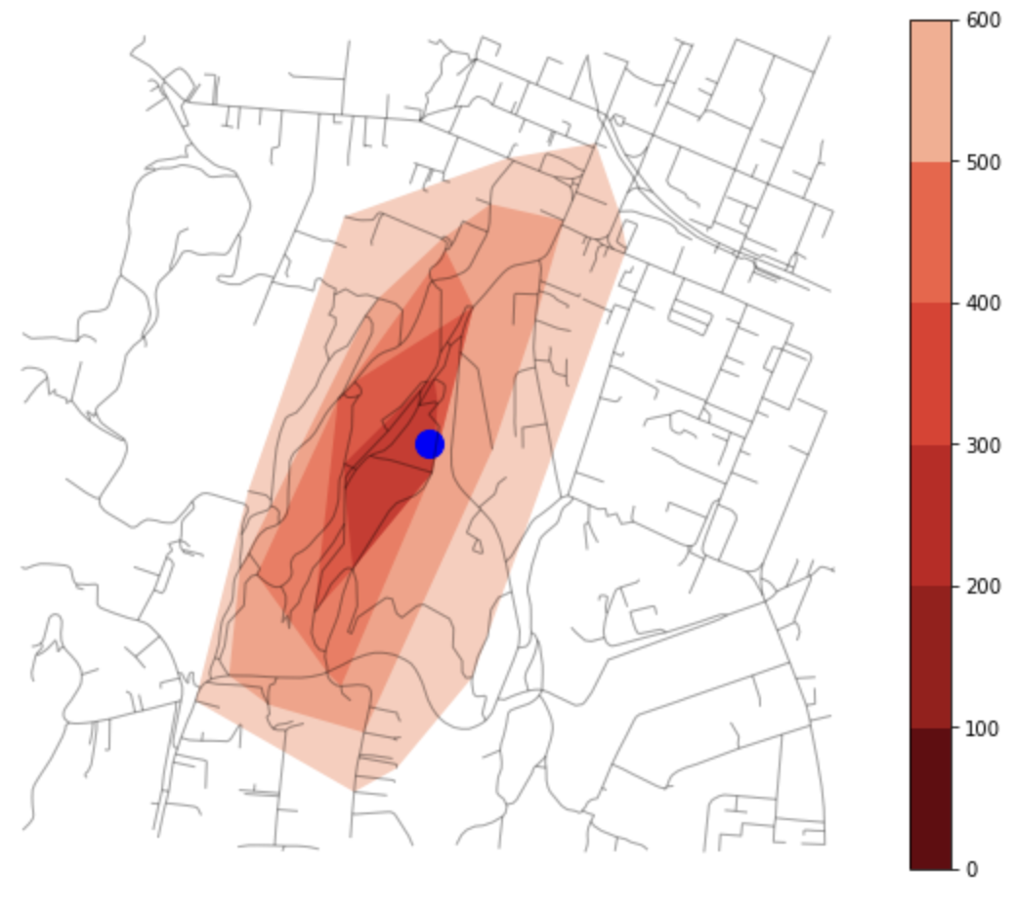
Routes to heatmaps and isochrones
Single route
Multiple routes
Catchment
Analysis with Python and the osmnx package. Code here.

Slide 17

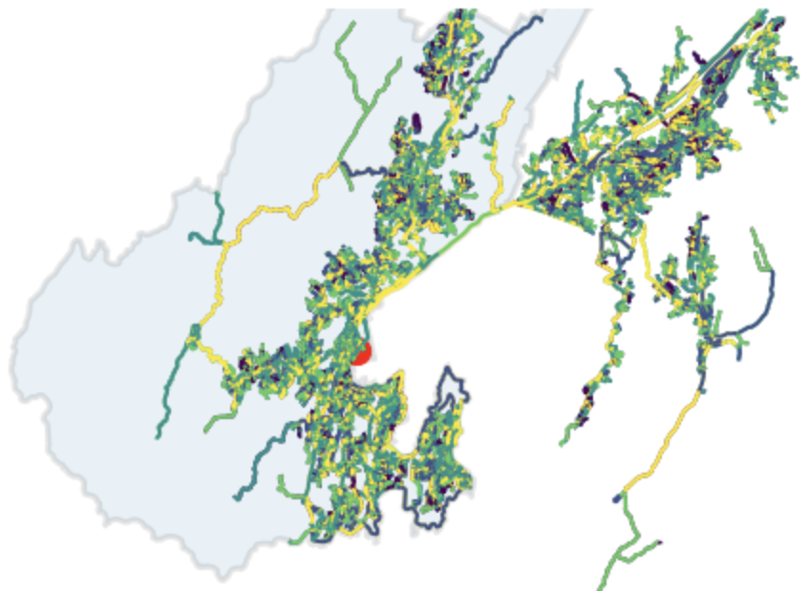
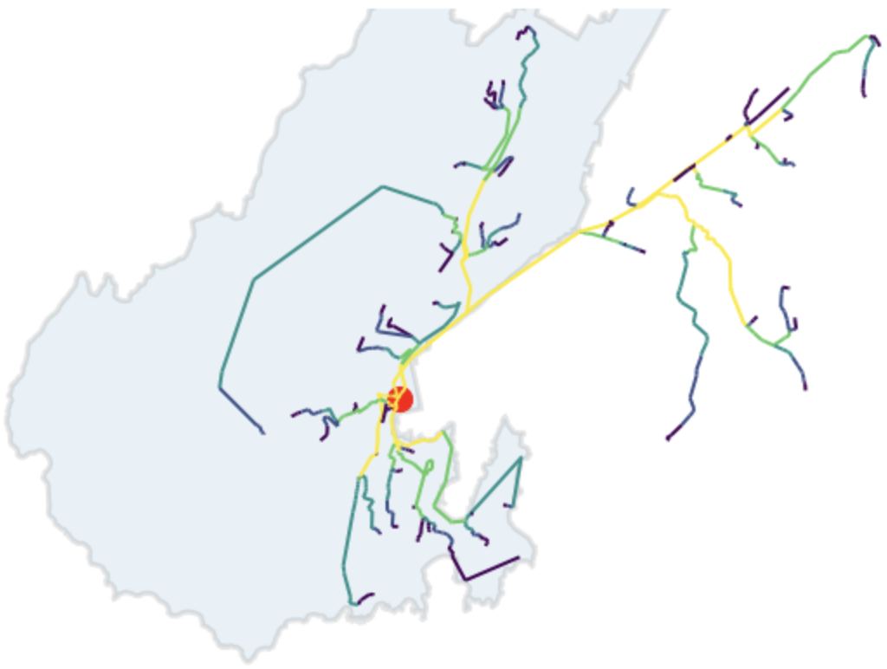
Finding arterial roads by counting routes
All flows to Wellington station
Top 5% flows to Wellington station
Analysis with Python and the osmnx and pandana packages. Code here.

Slide 18
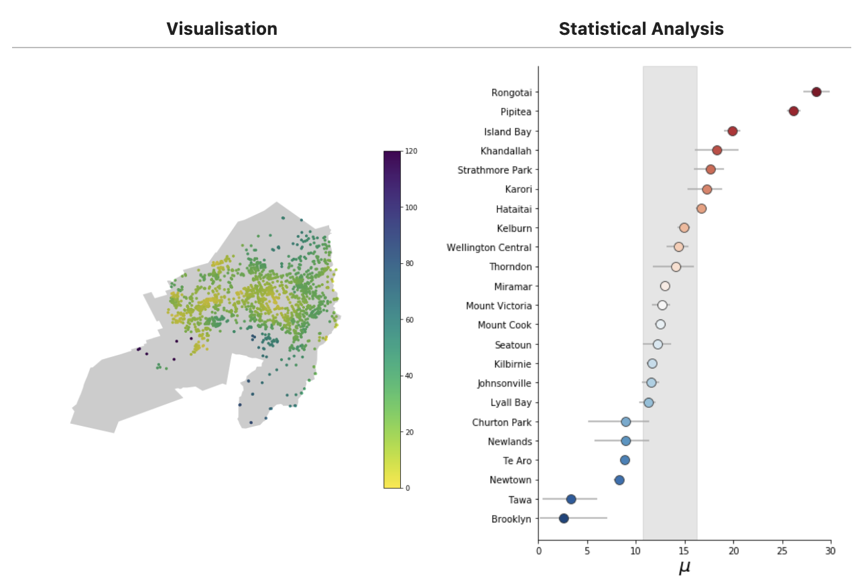
Walking to a playground in hilly Wellington
Digitally walking along Wellington streets to the nearest playground from every street intersection.
Vast differences in local walkability across the city even when there are multiple playgrounds in a given suburb.
Karori
Analysis with Python and the osmnx, pandana and pystan packages. Code here.

Slide 19
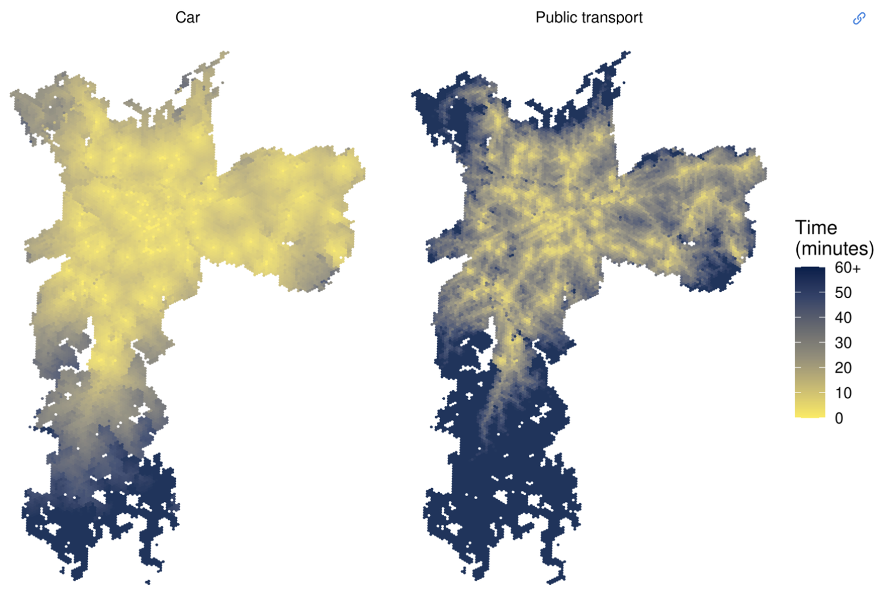
Patterns of access by mode
Travel times to a tertiary hospital in São Paulo, Brazil
Summarising routes across an entire city by mode to understand the car-centricity of cities.
Access via public transport tends to be “patchier” due to service extent and frequency.
Image reproduced from Introduction to urban accessibility with the accessibility package.

Slide 20
Buildings

Slide 21
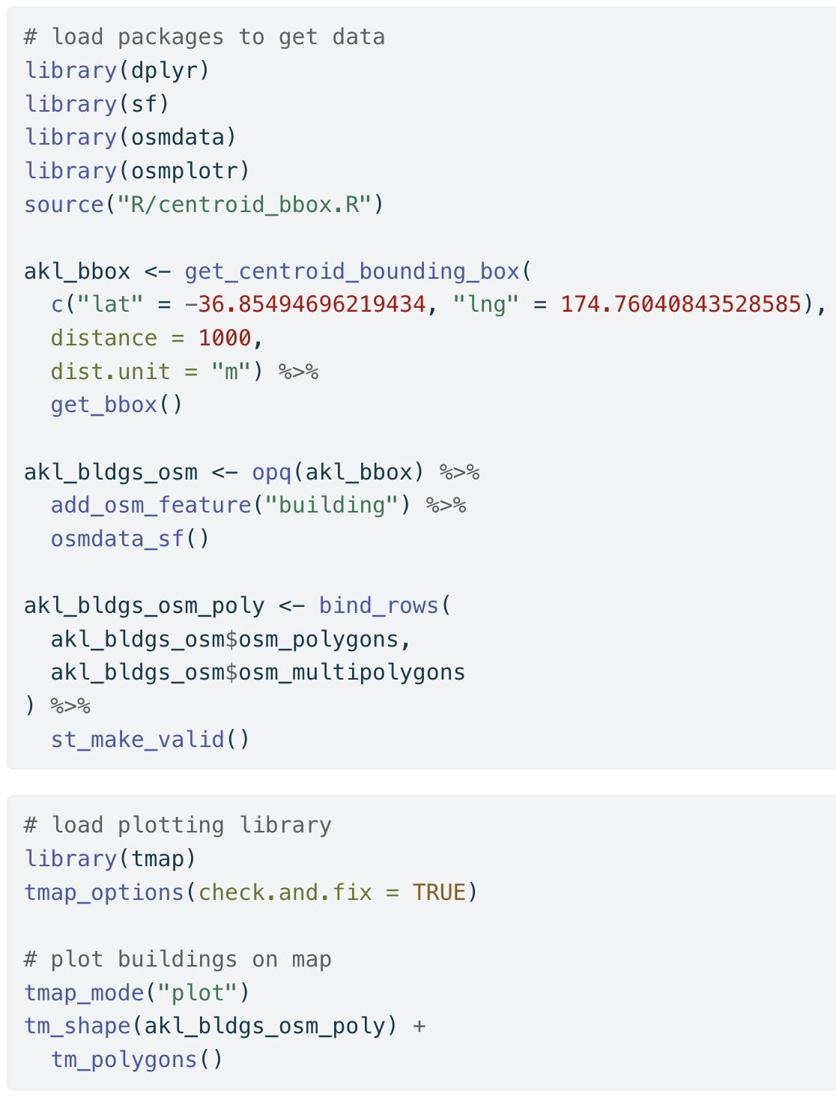
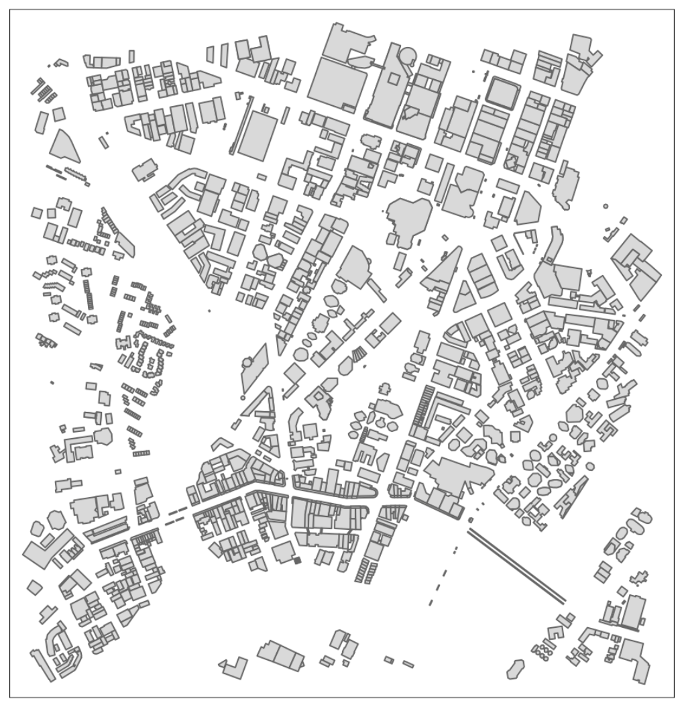
Getting data from OpenStreetMap

Slide 22
Figure-ground diagrams
Comparing urban design and structure at different scales.
A neighbourhood level (500m) shows the relative density of local buildings and the street network hierarchy.
British and British-influenced city neighbourhoods with lower building density and low traffic neighbourhoods.
Image made in R with the osmplotr package.

Slide 23
Resources
Companion web-book https://shriv.github.io/foss4g-2023/
Github repo https://github.com/shriv/foss4g-2023
Email me: s.ravi@transport.govt.nz
Email me: pentheseleia@gmail.com

